Slide 1


Dr. Nyoman Suwartha nsuwartha@eng.ui.ac.id
Forum Diskusi Partisipasi UGM dalam Green Metric World Rank
UI GreenMetric WUR:
Current Condition and Future Challenge
Universitas Gadjah Mada, Indonesia, 30 April 2018

Slide 2

Outline
Introduction
Methodology & Results
Concluding Remarks
UI GreenMetric World University Rankings 2018

Slide 3

UI GreenMetric Rankings
– the 8th year
Introduction

Slide 4





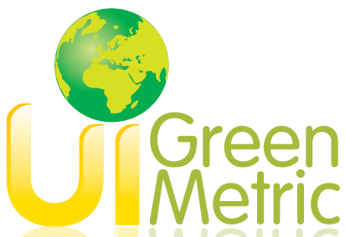


What is UI GreenMetric?
UI GreenMetric World University Rankings 2018

Slide 5
Overview of UIGM
Established: in April 2010
Strengths: Openness for global participation, accessibility for all HEIs in both the developed and developing world
Contribution:
academic discourse on sustainability in education and the greening of campuses
encourages university-led social change in the areas of sustainability
Identify important issues (calculable and comparable), move beyond eco-efficiency, measure process and motivations, stress on comprehensibility
Self assessment and online survey – http://greenmetric.ui.ac.id
UI GreenMetric World University Rankings 2018

Slide 6
Referred established models
College Green Report Card (www.greenreportcard.org)
Green League (https://peopleandplanet.org/university-league)
Green Cool University (http://www.sierraclub.org/sierra/coolschools-2015)
Sustainability Tracking Assessment and Rating System (STARS) – (https://stars.aashe.org/)
The Holcim Sustainability Awards,
GREENSHIP
Berlin Principles
UI GreenMetric World University Rankings 2018
UI GreenMetric©2016
UI GreenMetric World University Ranking 2017

Slide 7
UI GreenMetric Rankings
– Criteria & Process
Methodology & Results

Slide 8
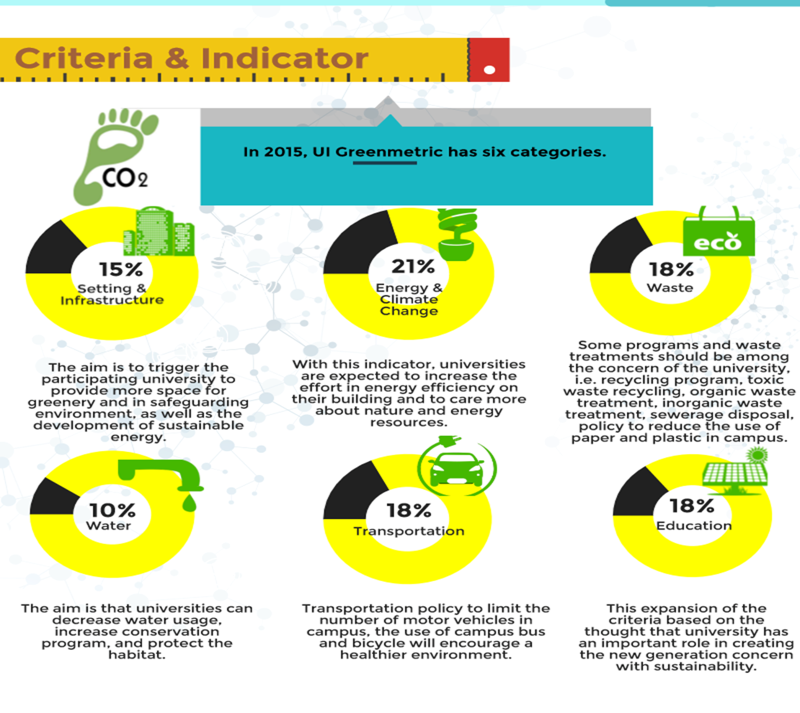
Criteria and Indicators
Setting and Infrastucture
The aim is to trigger the participating university to provide more space for greenery and in safeguarding environment, as well ad the development of sustainable energy
Energy and Climate Change
With this indicator, universities are expected to increase the effort in energy efficiency on their building and to care more about nature and energy resource
Waste
Some programs and waste treatments should be among the concern of the university, i.e. recycling program, toxic waste recycling, organic waste treatment, inorganic waste treatment, sewerage disposal, policy to reduce the use of paper and plastic in campus
Water
The aim is that universities can decrease water usage, increase conservation program, and protect the habitat
Transportation
Transportation policy to limit the number of motor vehicles in campus, the use of campus bus and bicycle will encourage a healthier environment
Education
This expansion of the criteria based on the thought that university has an important role in creating the new generation concern with sustainability
UI GreenMetric World University Rankings 2018

Slide 9
The Ranking Process
Development of Rankings and Methodology
Questionnaire Design
Data Submission (May 2018)
Sending invitations
Data Processing
Data validation (November 2018)
UI GreenMetric World University Rankings 2018

Slide 10
UI GreenMetric Rankings
– 8th Results
Methodology & Results

Slide 11
Increasing Number of Participants
 | 2010 | 2011 | 2012 | 2013 | 2014 | 2015 | 2016 | 2017
Number of universities participated | 95 | 178 | 215 | 301 | 360 | 407 | 515 | 619
Number of countries participated | 35 | 42 | 49 | 61 | 62 | 65 | 75 | 76
Number of universities participated from Indonesia | 22 | 25 | 26 | 28 | 28 | 49 | 49 | 57
UI GreenMetric World University Rankings 2018

Slide 12
619 universities
76 countries
Participating institutions located on the dynamic, and diverse Africa, Asia, Europe, America and Oceania.
UI GreenMetric World University Rankings 2018

Slide 13
1,693,974 faculty member
21,499,456 students
More than US$ 9,906,897,311.27 total research fund on environment and sustainability
UI GreenMetric World University Rankings 2018

Slide 14
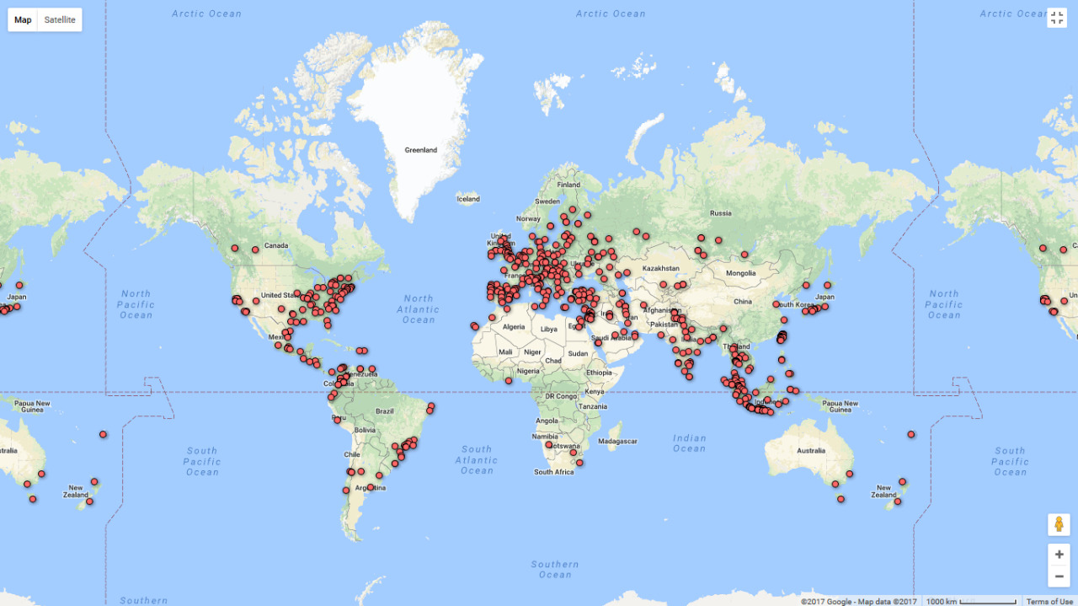
Participants from all regions (2017)
America (149 Universities)
Brazil (17), Chile (4), Colombia (31), Ecuador (2), Peru (1), Mexico (13), Argentina (3), Canada (10), US (60), Puerto Rico (1), Panama (1), Republic of Trinidad and Tobago (1), El Salvador (1), Honduras (1), Nicaragua (1), Venezuela (2),
Regions | No. Univ
Asia | 251
Africa | 11
Amerika | 149
Europe | 202
Oceania | 6
Total | 619
UI GreenMetric World University Rankings 2018

Slide 15
Participants from all regions (2017)
Africa (11 Universities)
South Africa (2), Egypt (5), Marocco (1), Algeria (1), Tunisia (1), Namibia (1)
UI GreenMetric World University Rankings 2018
UI GreenMetric©2016

Slide 16
Participants from all regions (2017)
Asia (251 Universities)
China (2), Japan (9), Chinese Taipei (29), Pakistan (6), India (24), Sri Lanka (2), Bangladesh (2), Indonesia (57), Malaysia (15), Thailand (27), Vietnam (2), Philippines (4), Turkey (26), Iraq (4), Kazakhstan (5), Kyrgyzstan (1), Azerbaijan (1), Israel (4), Lebanon (2), Occupied Palestinian Territory (4), Saudi Arabia (3), United Emirates Arab (2), Iran (10), Jordan (8), Bahrain (1)
UI GreenMetric World University Rankings 2018

Slide 17
Indonesian Universities in UI GreenMetric 2017
No. | University | Ranking
1. | University of Indonesia | 23
2. | Bogor Agricultural University | 52
3. | Institut Teknologi Sepuluh Nopember | 57
4. | Universitas Negeri Semarang | 84
5. | Universitas Sebelas Maret | 95
6. | Diponegoro University | 103
7. | Brawijaya University | 161
8. | Universitas Islam Indonesia | 167
9. | Telkom University | 182
10. | Universitas Padjadjaran | 184
11. | Universitas Sumatera Utara | 234
12. | Universitas Multimedia Nusantara | 240
13. | Universitas Riau | 264

Slide 18
Indonesian Universities in UI GreenMetric 2017
No. | University | Ranking
14. | Universitas Mataram | 292
15. | Institute of Technology Bandung | 301
16. | Andalas University | 319
17. | Airlangga University | 361
18. | Universitas Negeri Medan | 389
19. | Universitas Pelita Harapan | 404
20. | Universitas Lampung | 437
21. | Yogyakarta State University | 448
22. | Universitas Syiah Kuala | 455
23. | Universitas Teuku Umar | 468
24. | Universitas Bengkulu | 470
25. | Universitas Surabaya | 473
26. | Universitas Terbuka | 482

Slide 19
Indonesian Universities in UI GreenMetric 2017
No. | University | Ranking
27. | Hasanuddin University | 487
28. | Universitas Sanata Dharma | 493
29. | Universitas Medan Area | 505
30. | Universitas Bangka Belitung | 510
31. | Universitas Jember | 512
32. | Universitas Negeri Surabaya | 513
33. | Universitas Pancasila | 515
34. | Universitas Sriwijaya | 522
35. | Universitas Pembangunan Nasional Veteran Yogyakarta | 524
36. | Universitas Maritim Raja Ali Haji | 535
37. | Universitas Negeri Manado | 537
38. | Universitas Muhammadiyah Surakarta | 538
39. | Universitas Sam Ratulangi | 540

Slide 20
Indonesian Universities in UI GreenMetric 2017
No. | University | Ranking
40. | Universitas Tanjungpura | 543
41. | Gunadarma University | 549
42. | Universitas Halu Oleo | 552
43. | Atma Jaya Yogyakarta University | 565
44. | Universitas Negeri Malang | 566
45. | Sekolah Tinggi Teknik Malang | 580
46. | Petra Christian University | 583
47. | Universitas PGRI Ronggolawe | 584
48. | Universitas Tarumanagara | 587
49. | Universitas Negeri Padang | 590
50. | Universitas Samudera | 602
51. | Universitas Lambung Mangkurat | 604
52. | Universitas Islam Negeri Maulana Malik Ibrahim Malang | 608

Slide 21
Indonesian Universities in UI GreenMetric 2017
No. | University | Ranking
53. | Universitas Islam Negeri Sumatera Utara Medan | 609
54. | Universitas Khairun | 610
55. | Universitas Pendidikan Ganesha (UNDIKSHA) | 612
56. | Politeknik Negeri Malang | 615
57. | Universitas Muria Kudus | 619

Slide 22
Participants from all regions (2017)
Europe (202 Universities)
Czech Republic (3), Hungary (9), Poland (6), Romania (5), Russian Federation (30), Macedonia (1), Denmark (2), Finland (4), Ireland (5), Latvia (5), Lithuania (1), Sweden (4), UK (26), Greece (4), Italy (22), Spain (29), Portugal (3), Cyprus (3), Serbia (1), Austria (4), Belgium (0), France (6), Germany (11), Netherland (7), Switzerland (1), Ukraine (7), Slovenia (3)
UI GreenMetric World University Rankings 2018

Slide 23
Participants from all regions (2017)
Oceania (6 Universities)
Australia (3), Fiji (1), New Zealand (2)
UI GreenMetric World University Rankings 2018

Slide 24
Universities performance per region
*African universities = 11 participants (2017 data)
UI GreenMetric World University Rankings 2018

Slide 25
Universities performance per region
*Asian universities = 235 participants (2017 data)
UI GreenMetric World University Rankings 2018

Slide 26
Universities performance per region
*European universities = 214 participants (2017 data)
UI GreenMetric World University Rankings 2018

Slide 27
Universities performance per region
*North American universities = 84 participants (2017 data)
UI GreenMetric World University Rankings 2018

Slide 28
Universities performance per region
*South American universities = 64 participants (2017 data)
UI GreenMetric World University Rankings 2018

Slide 29
Universities performance per region
*Oceania universities = 6 participants (2017 data)
UI GreenMetric World University Rankings 2018

Slide 30
UIGM results’ trend per region
UIGM Score
Number of universities
*All 619 participants (2017 data)
UI GreenMetric World University Rankings 2018

Slide 31
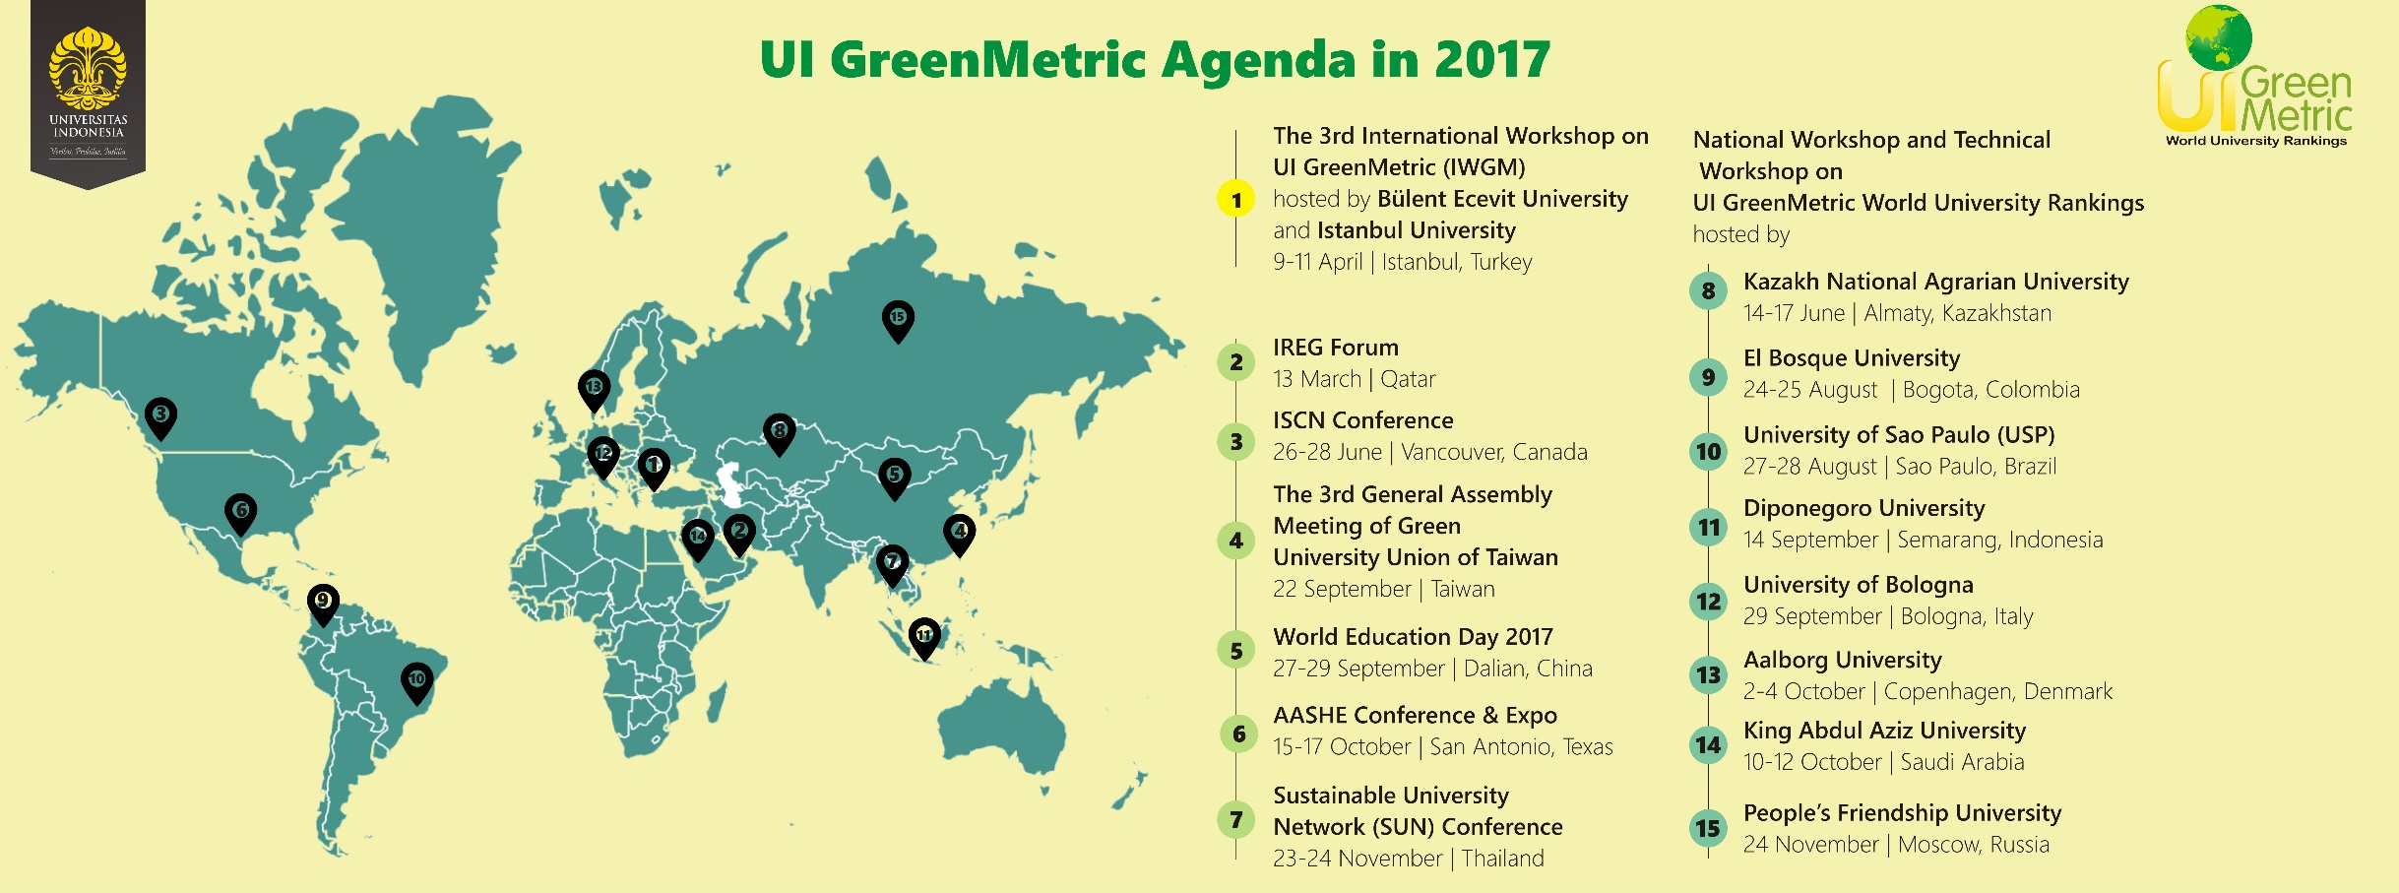
2017 Completed Agenda
UI GreenMetric World University Rankings 2018

Slide 32
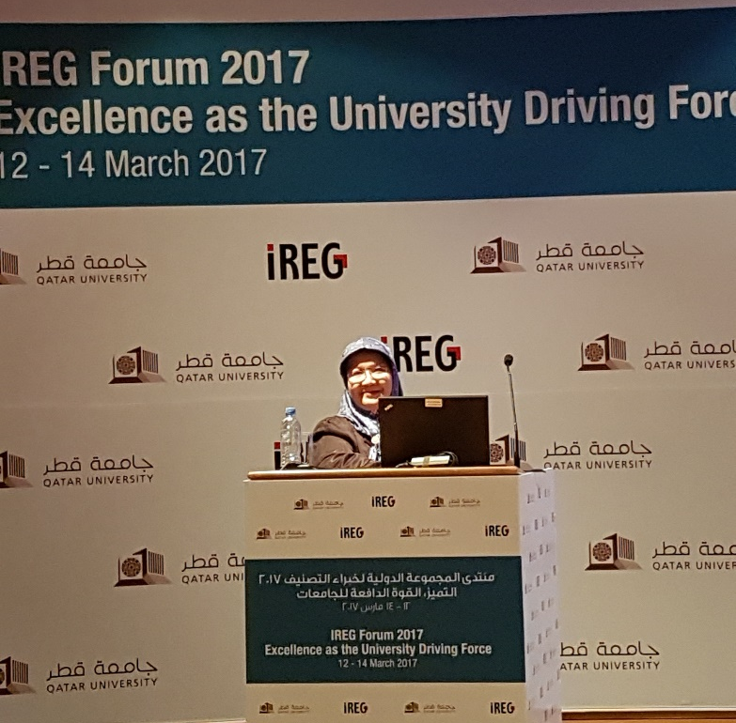
International Exposure
The UI GreenMetric World University Rankings Session at
IREG Forum 2017
Doha, Qatar
on 12-14 March, 2017
120 Participants from 35 Universities
UI GreenMetric World University Rankings 2018

Slide 33
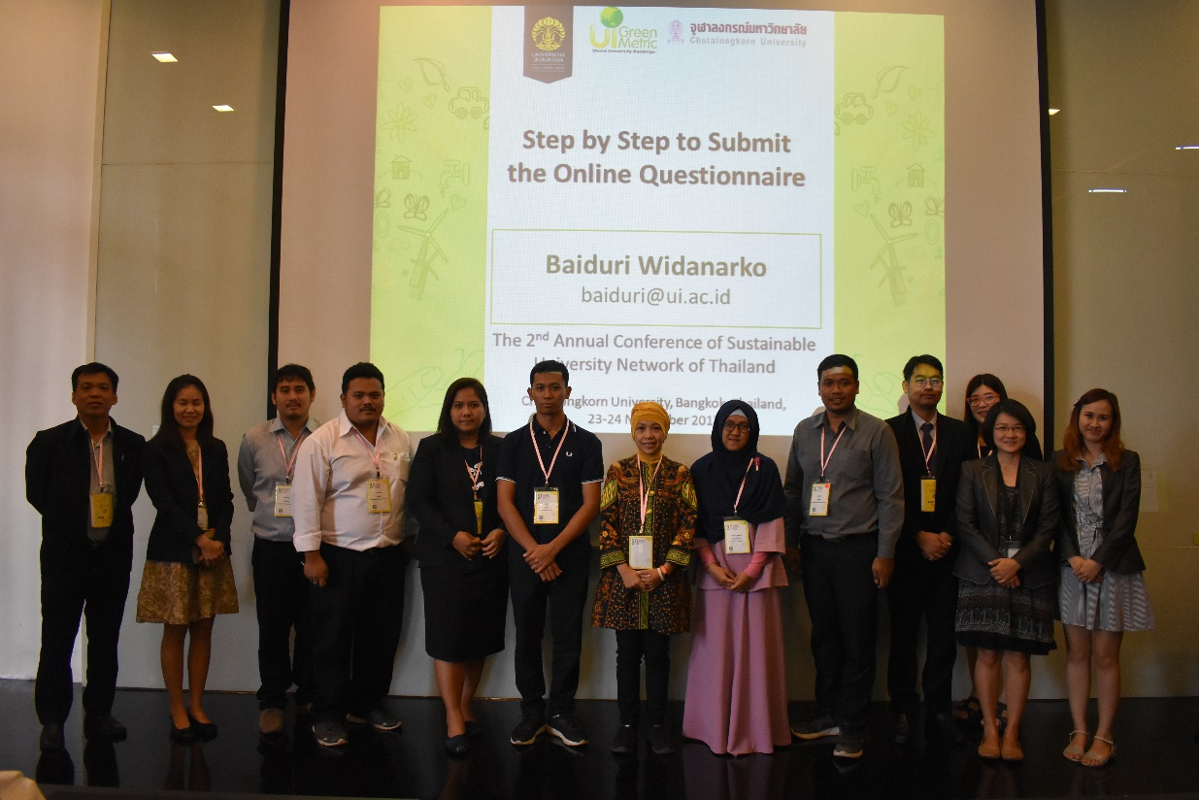
UI GreenMetric Session
The UI GreenMetric World University Rankings Session at
The Sustainable University Network (SUN) Confrerence
Bangkok, Thailand
On June 14-17, 2017
11 Participants from 7 Universities
UI GreenMetric World University Rankings 2018

Slide 34
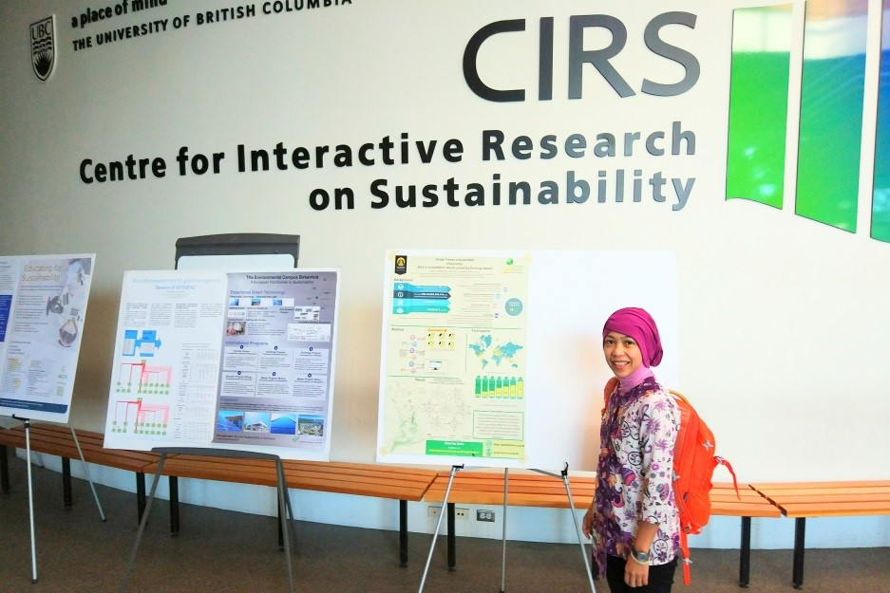
International Exposure
The UI GreenMetric World University Rankings Session at
The International Sustainable Campus Network (ISCN) Conference
Vancouver, Canada
on 26-28 June 2017
UI GreenMetric World University Rankings 2018

Slide 35
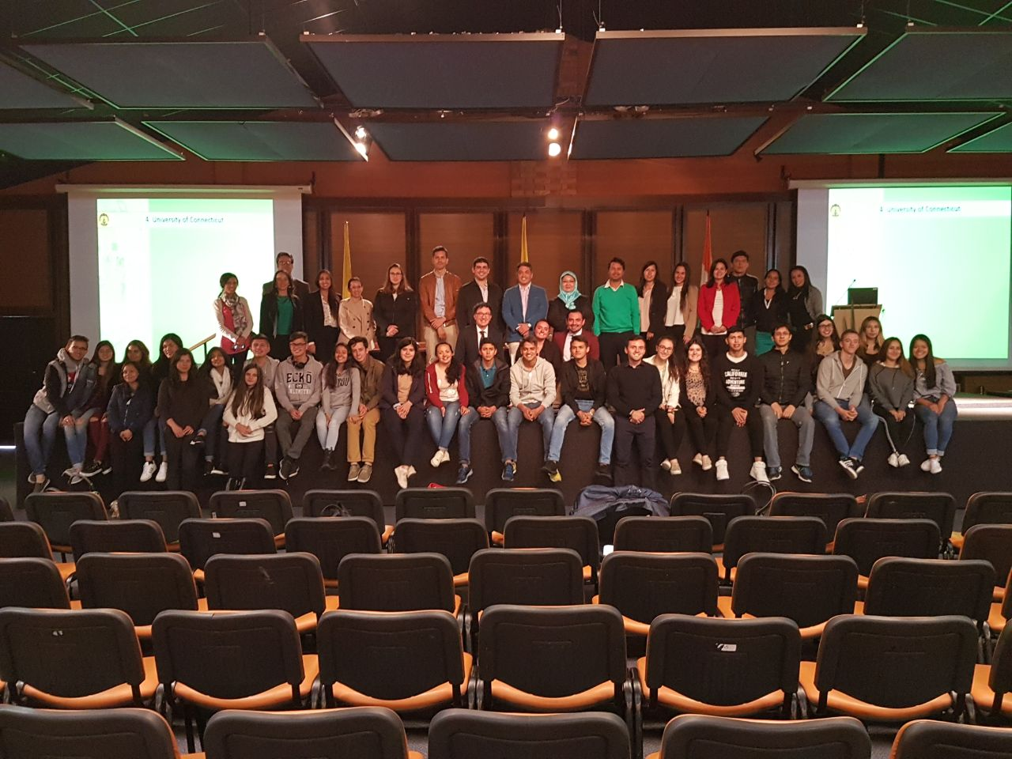
National Workshop on UI GreenMetric
The National Workshop on UI GreenMetric World University Rankings (IWGM) in
University of El Bosque
Colombia
On 24-25 August, 2017
46 Participants from 11 Universities
UI GreenMetric World University Rankings 2018

Slide 36
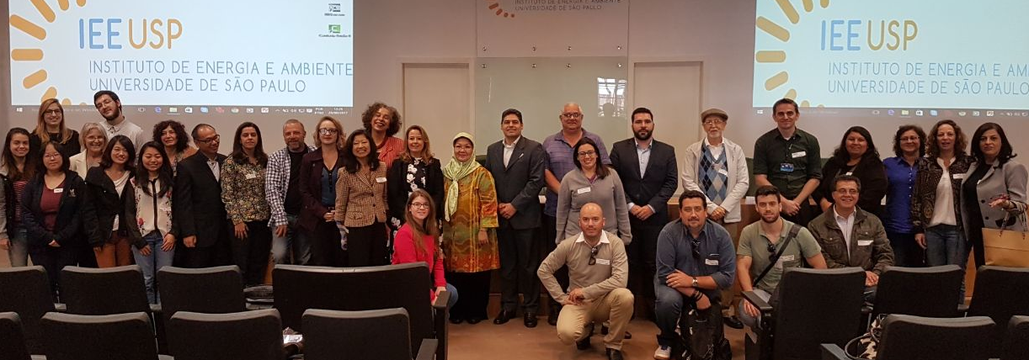
National Workshop on UI GreenMetric
The National Workshop on UI GreenMetric World University Rankings (IWGM) in
University of Sao Paulo (USP)
Brazil
On 27-28 August 2017
37 Participants from 22 Universities
UI GreenMetric World University Rankings 2018

Slide 37
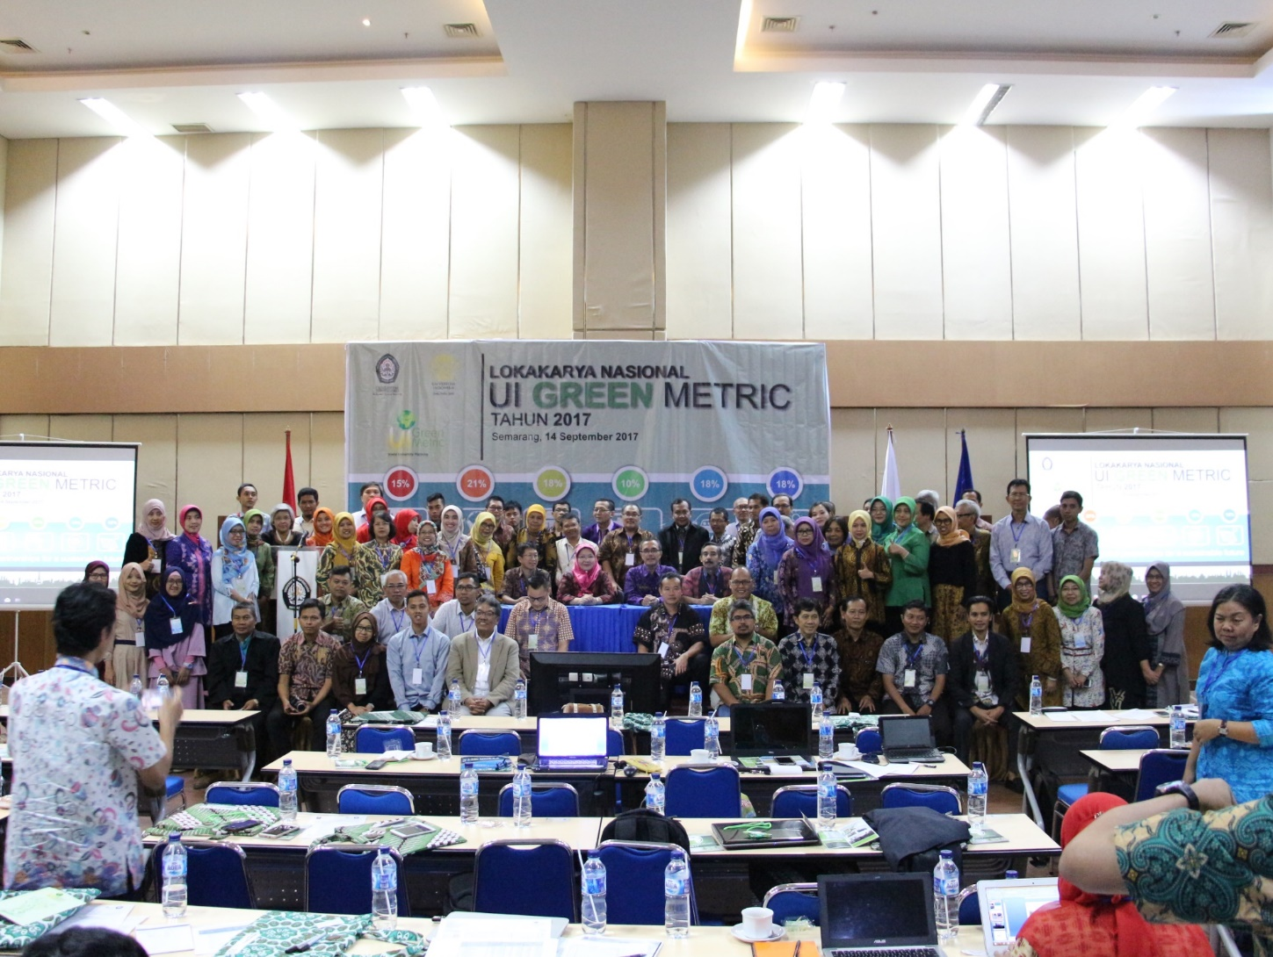
National Workshop on UI GreenMetric
The National Workshop on UI GreenMetric World University Rankings (IWGM) in
Diponegoro University
Indonesia
On 14 September, 2017
78 Participants from 38 Universities
UI GreenMetric World University Rankings 2018

Slide 38
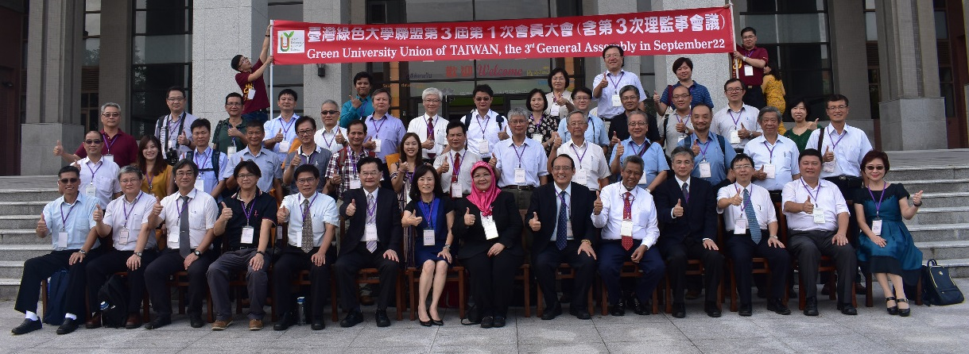
UI GreenMetric Session
The UI GreenMetric World University Rankings Session in collaboration with NPUST and NCKU at
The 3rd General Assembly Green University Union of Taiwan (GUUT) 2017
Nantau, Taiwan
on 22 September 2017
48 Participants from 43 Universities
UI GreenMetric World University Rankings 2018

Slide 39
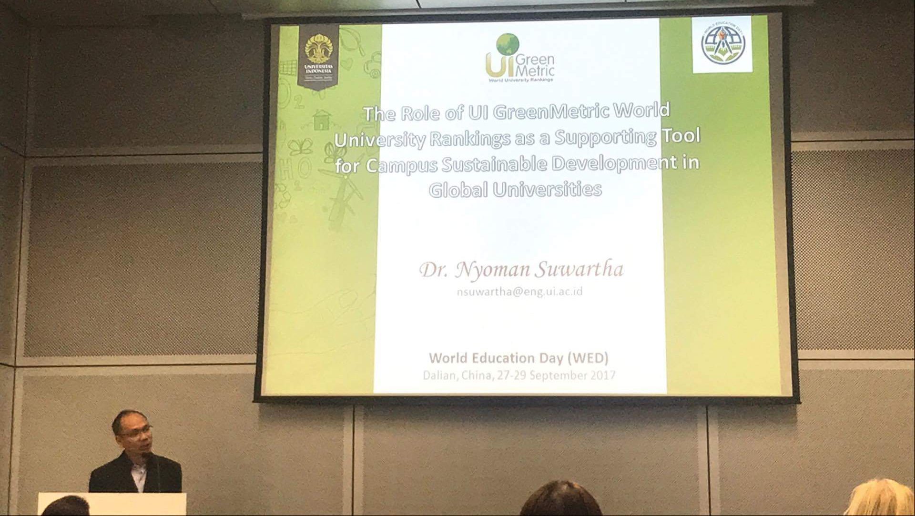
International Exposure
The UI GreenMetric World University Rankings Session at
The World Education Day (WED) 2017
Dalian, China
on 27 29 September 2017
UI GreenMetric World University Rankings 2018

Slide 40
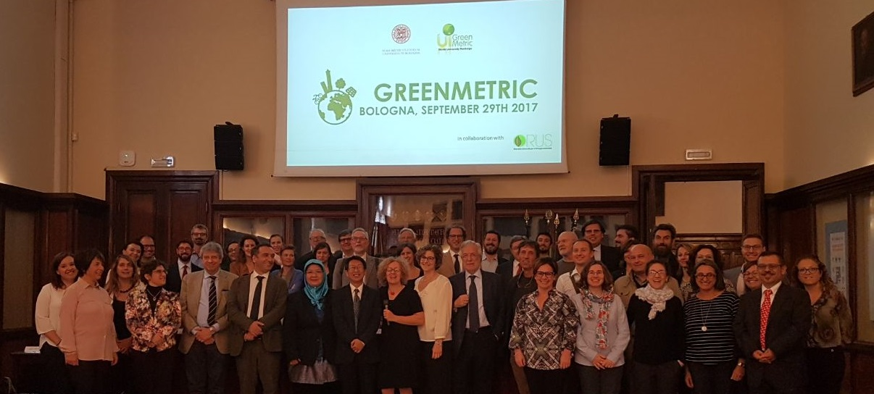
National Workshop on UI GreenMetric
The National Workshop on UI GreenMetric World University Rankings (IWGM) in
University of Bologna
Italy
On 29 September, 2017
60 Participants from 30 Universities
UI GreenMetric World University Rankings 2018

Slide 41
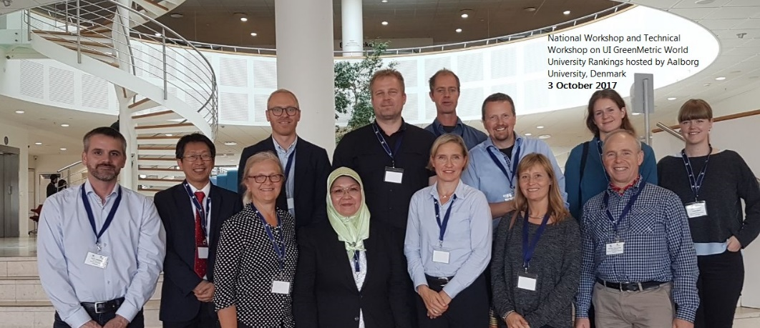
National Workshop on UI GreenMetric
The National Workshop on UI GreenMetric World University Rankings (IWGM) in
Aalborg University Denmark
On 3 October, 2017
15 Participants from 4 Universities
UI GreenMetric World University Rankings 2018

Slide 42
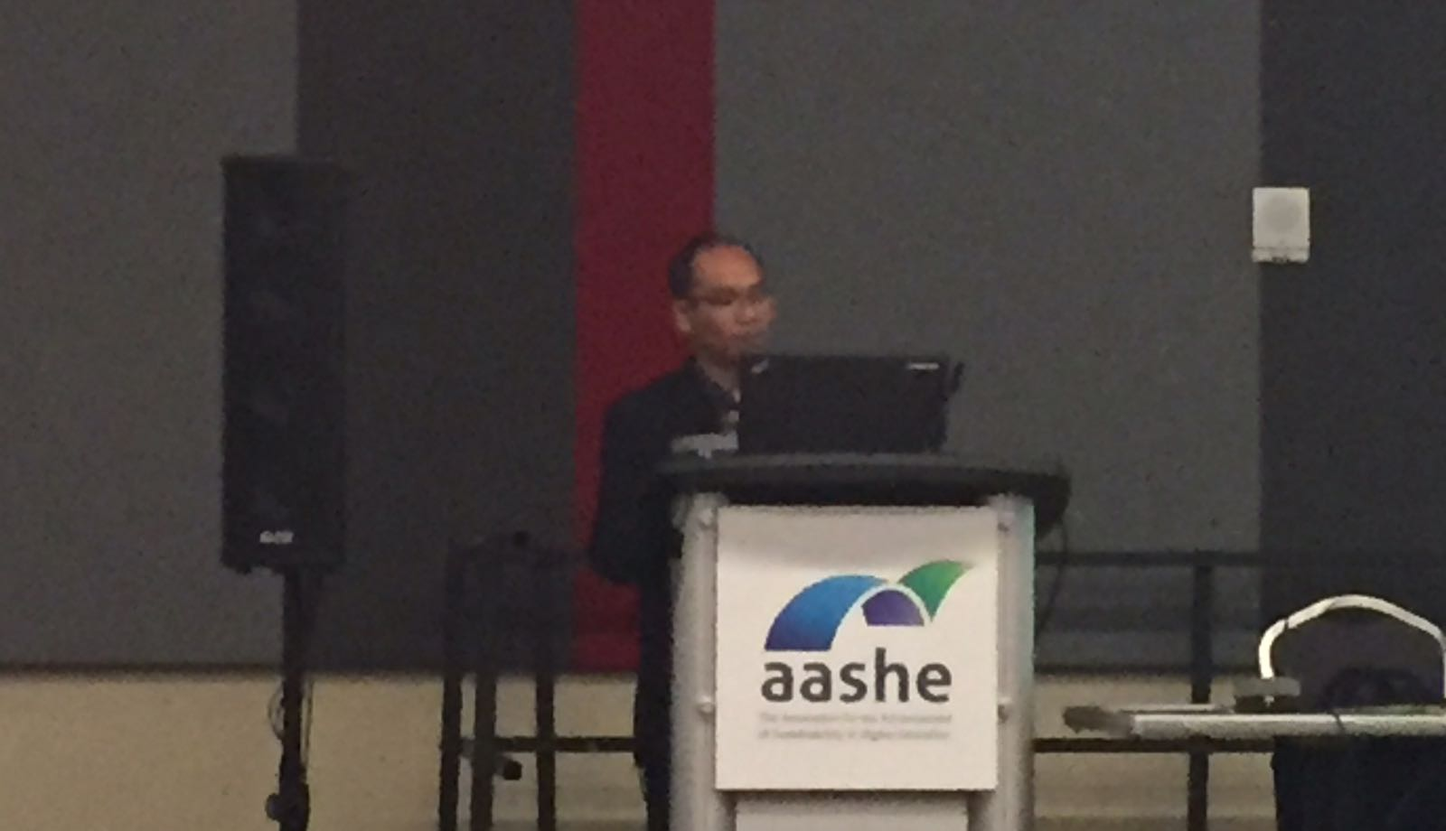
International Exposure
The UI GreenMetric World University Rankings Session at
The Association for the Advancement of Sustainability in Higher Education (AASHE) Conference 2017
San Antonio, Texas
on 15-17 October, 2017
UI GreenMetric World University Rankings 2018

Slide 43
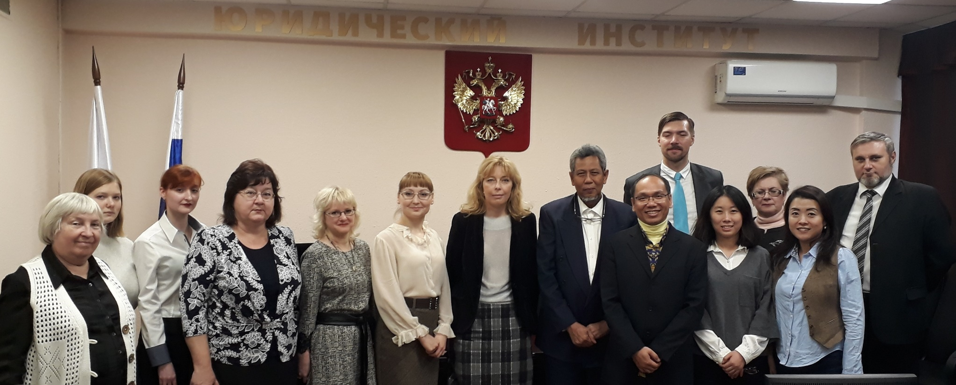
National Workshop on UI GreenMetric
The National Workshop on UI GreenMetric World University Rankings (IWGM) in
People’s Friendship University (RUDN)
Moscow, Russia
On 24 November, 2017
12 Participants from 5 Universities
UI GreenMetric World University Rankings 2018

Slide 44
UI GreenMetric Rankings
– near future Challenges
Concluding Remarks

Slide 45
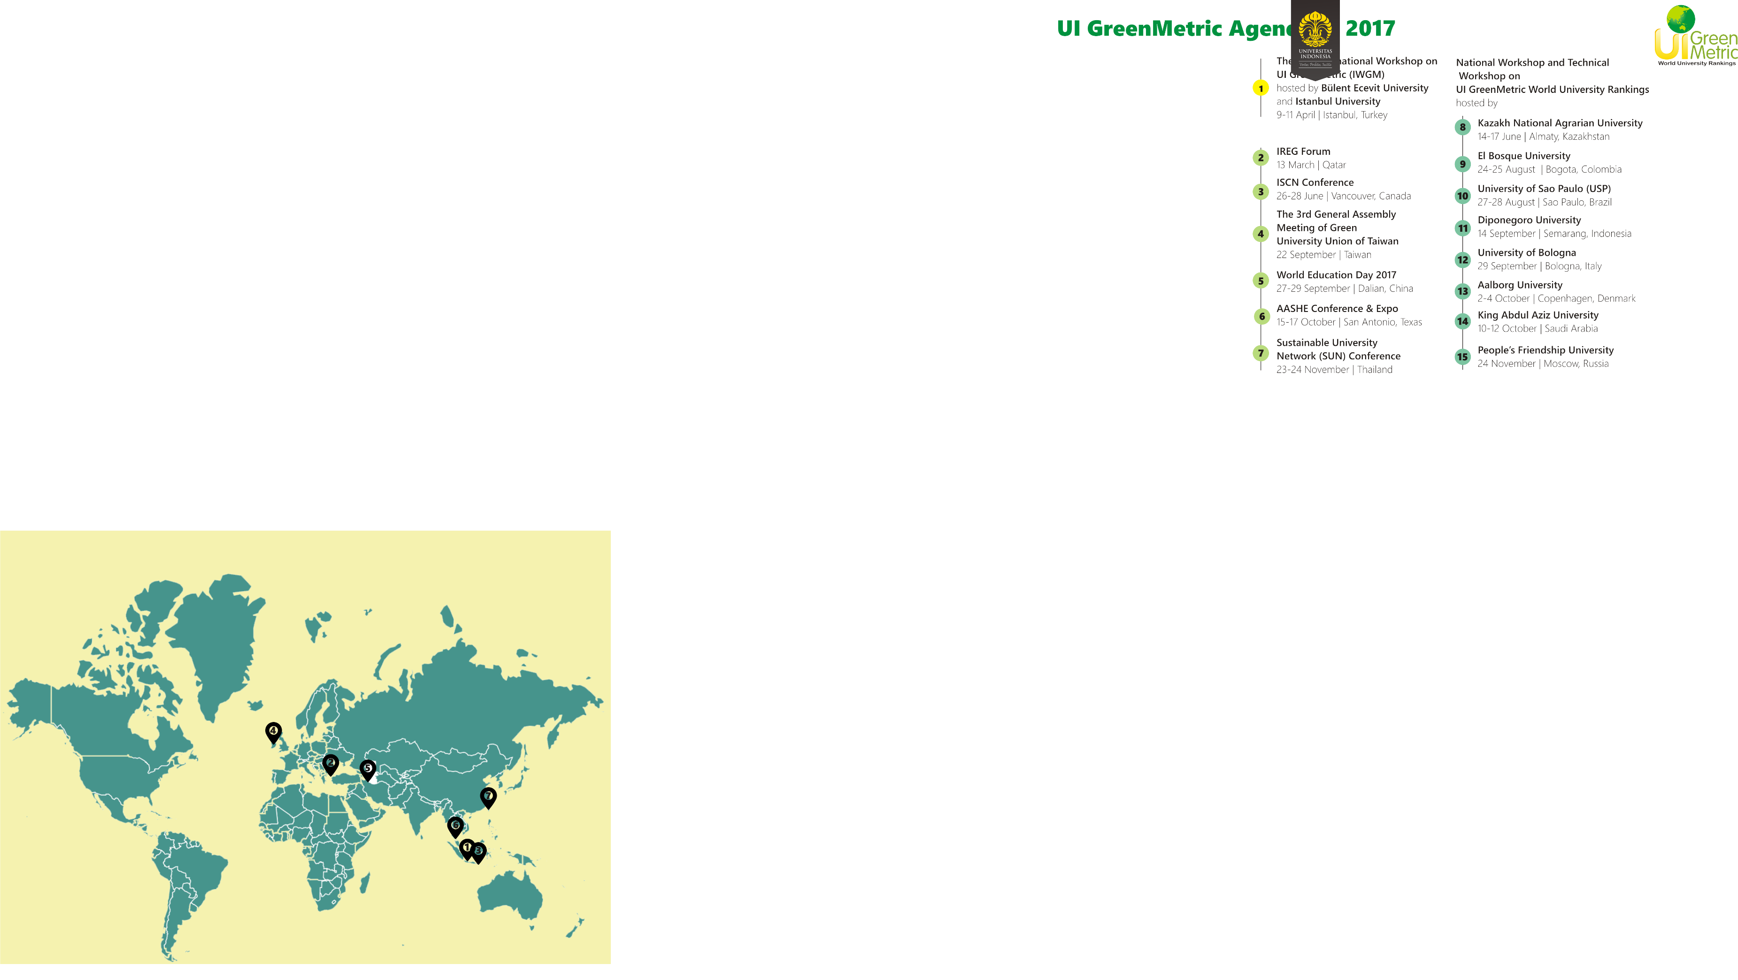
International Workshop on UI GreenMetric (IWGM) 2013-2022
2013 and 2016
University of Indonesia
Depok, Indonesia
2017
Istanbul University
Bulent Ecevit University
Istanbul, Turkey
2018
Universitas Diponegoro
Semarang, Indonesia
2019
University College Cork
Ireland
2020
University of Zanjan
Iran
2021
Universiti Utara Malaysia
Malaysia
2022
National Pingtung University
of Science and Technology
Taiwan
1
2013 International Workshop on UI GreenMetric World University Rankings, hosted by in University of Indonesia, Indonesia
2016 International Workshop on UI GreenMetric World University Rankings, hosted by in University of Indonesia, Indonesia
2017 International Workshop on UI GreenMetric World University Rankings, hosted by in Istanbul University and Bulent Ecevit, Turkey
2018 International Workshop on UI GreenMetric World University Rankings, hosted by Universitas Diponegoro, Indonesia
2019 International Workshop on UI GreenMetric World University Rankings, hosted by University College Cork, Ireland
2020 International Workshop on UI GreenMetric World University Rankings, hosted by University of Zanjan, Iran
2021 International Workshop on UI GreenMetric World University Rankings, hosted by Universiti Utara Malaysia, Malaysia
2022 International Workshop on UI GreenMetric World University Rankings, hosted by National Pingtung University of Science and Technology, Taiwan
2
3
4
5
6
7
UI GreenMetric World University Rankings 2018

Slide 46
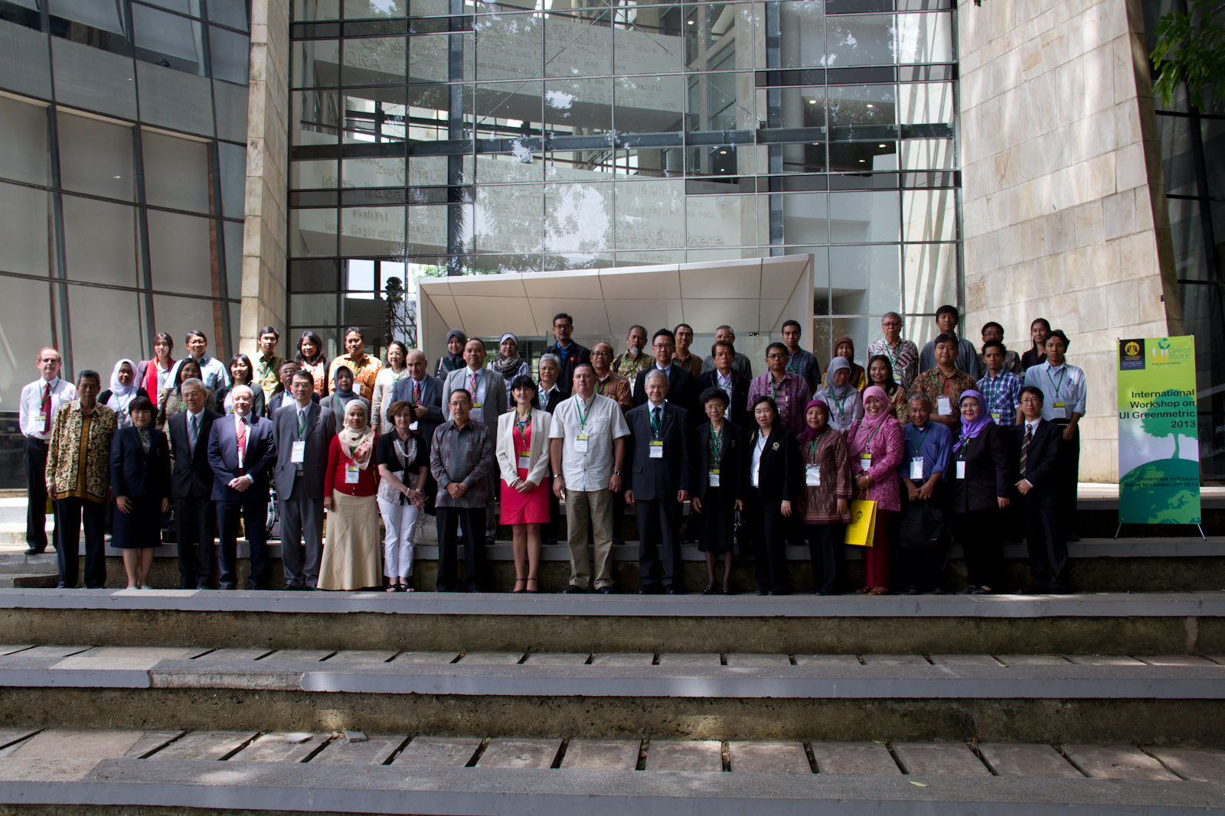
2013 International Workshop on UI GreenMetric (IWGM)
The 1st International Workshop on UI GreenMetric World University Rankings (IWGM) 2013 in collaboration with University of Indonesia
in Depok, Indonesia
in April 2013
UI GreenMetric World University Rankings 2018

Slide 47
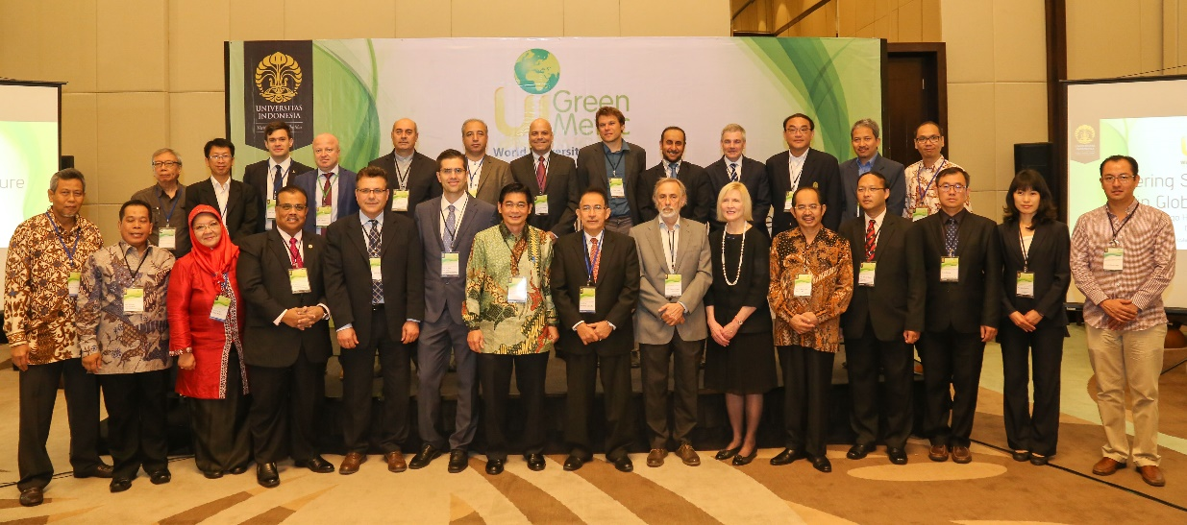
2016 International Workshop on UI GreenMetric (IWGM)
The 2nd International Workshop on UI GreenMetric World University Rankings (IWGM) 2016 in collaboration with University of Indonesia
in Depok, Indonesia
in April 2016
UI GreenMetric World University Rankings 2018

Slide 48
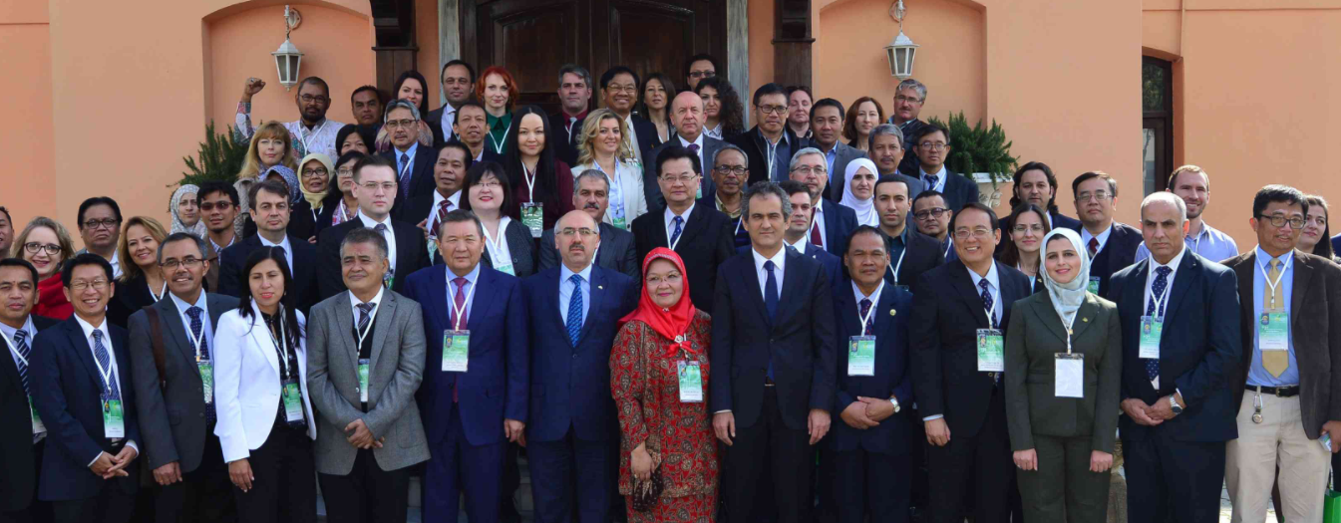
2017 International Workshop on UI GreenMetric (IWGM)
The 3rd International Workshop on UI GreenMetric World University Rankings (IWGM) 2017
in collaboration with Bülent Ecevit University and Istanbul University
in Istanbul, Turkey
on 9-11 April 2017
UI GreenMetric World University Rankings 2018

Slide 49
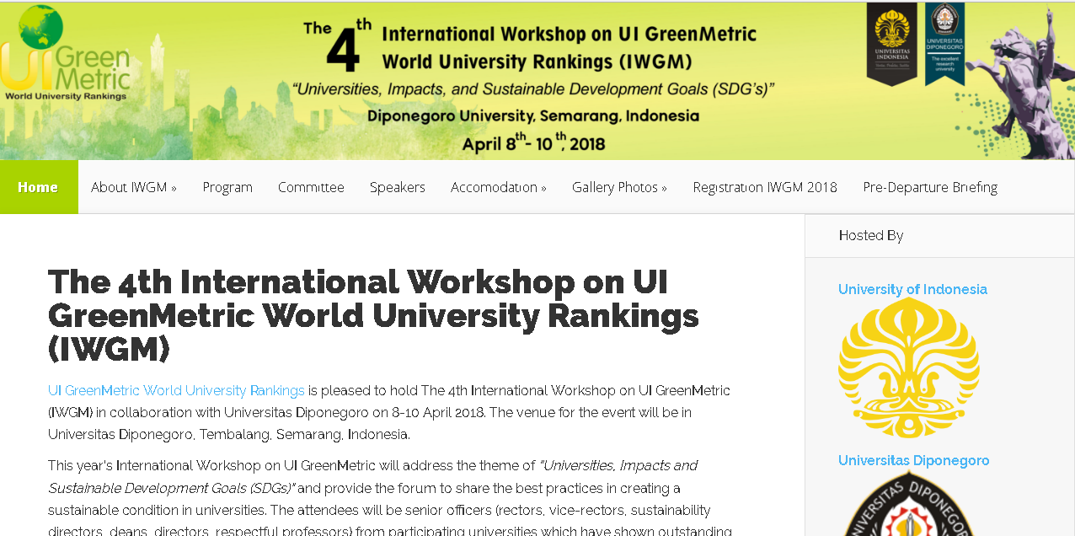
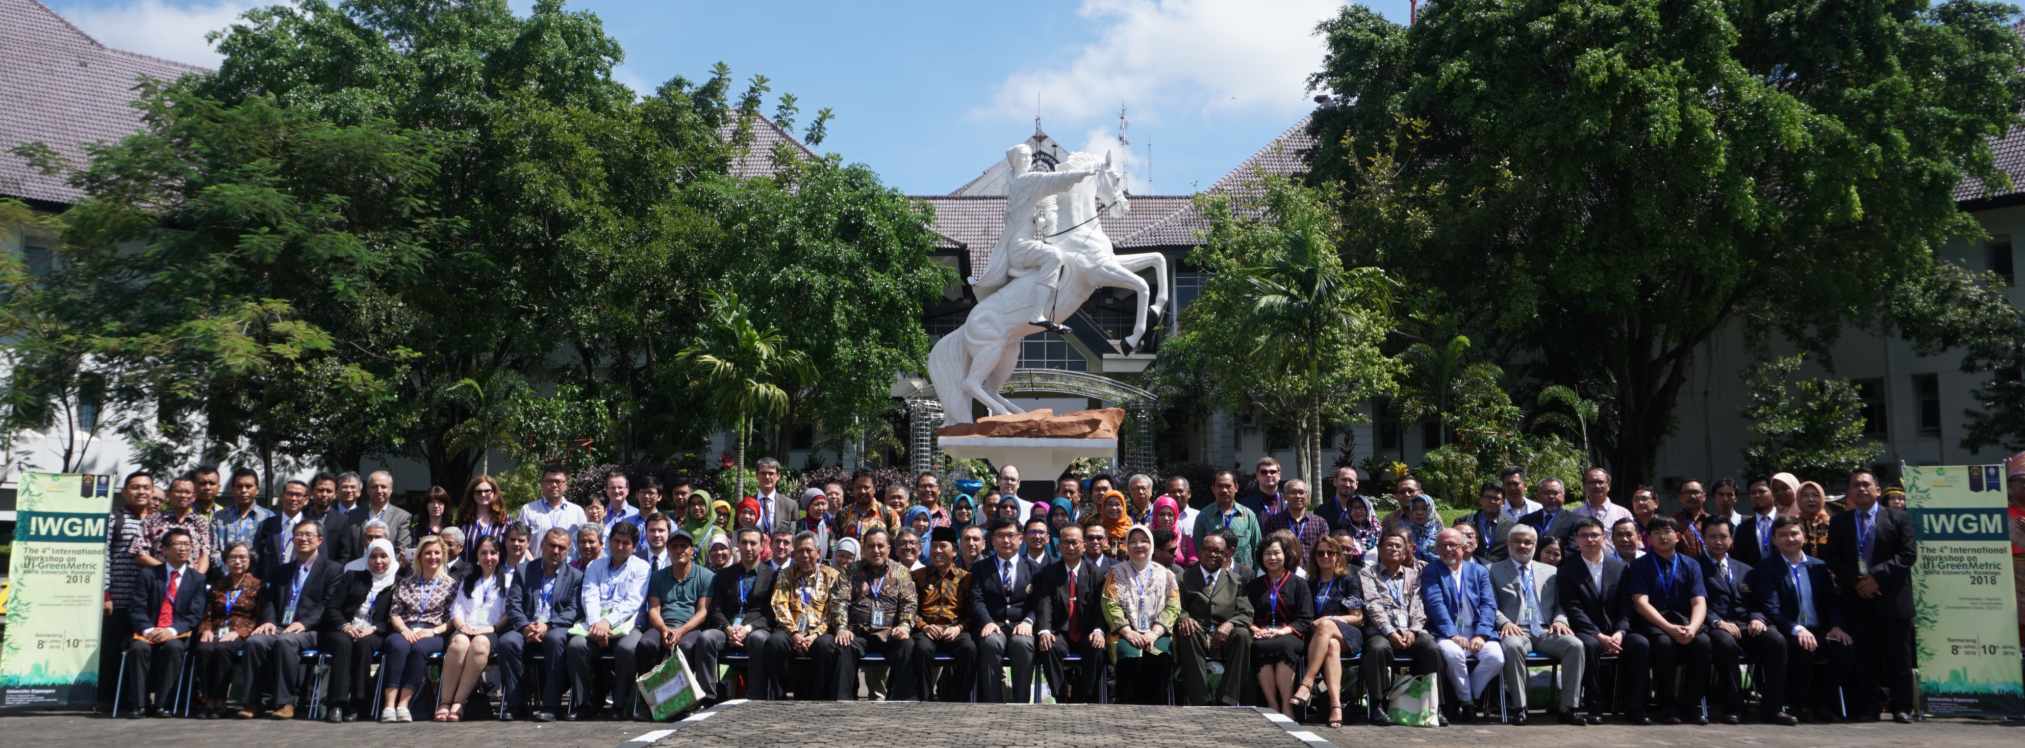
The 4th International Workshop on UI GreenMetric World University Rankings (IWGM) 2018 in collaboration with Universitas Diponegoro
in Semarang, Indonesia
in April 2018
UI GreenMetric World University Rankings 2018

Slide 50
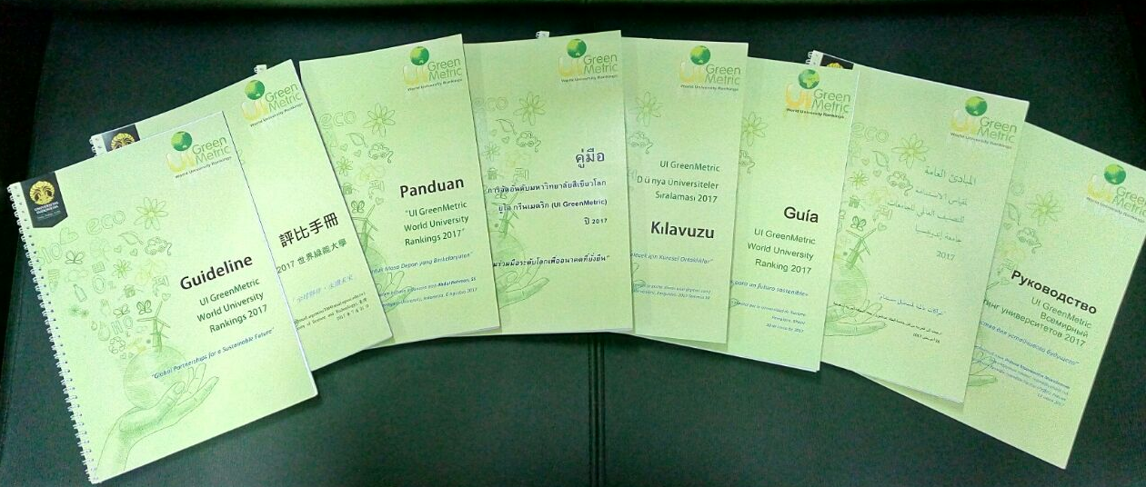
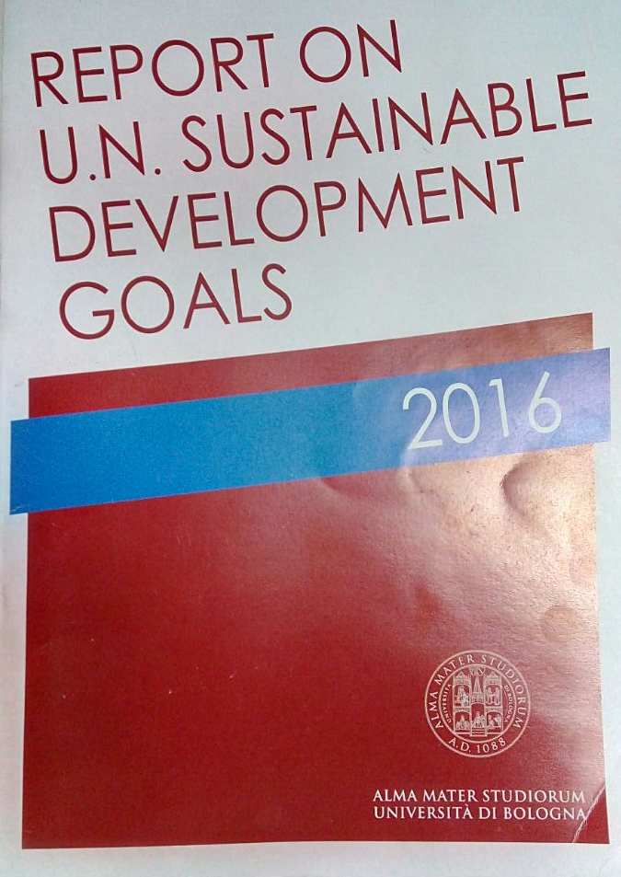
UI GreenMetric World University Rankings 2018

Slide 51
Trends & Findings
Leadership has been shown by 247 universities that submitted evidence
The majority are dedicated to having their university become more sustainable.
The most significant constraints to moving toward sustainability:
                - financial predicaments
                - lack of understanding and awareness of sustainability issues
                - a resistance to change.
All university stakeholders should have a common understanding of the term sustainable development
UI GreenMetric World University Rankings 2018

Slide 52
Challenges
In order to make make better impact to achieving SDGs, university need to put more efforts on the six criteria of UIGM, particularly on “energy and climate change”
Higher education has a crucial role to play in addressing these challenge:
  - Smart building implementation
  - Renewable energy
  - Carbon footprint evaluation
  - Green Building Certification/Acknowledgement
Report on SDGs achievement
UI GreenMetric World University Rankings 2018
UI GreenMetric©2016

Slide 53
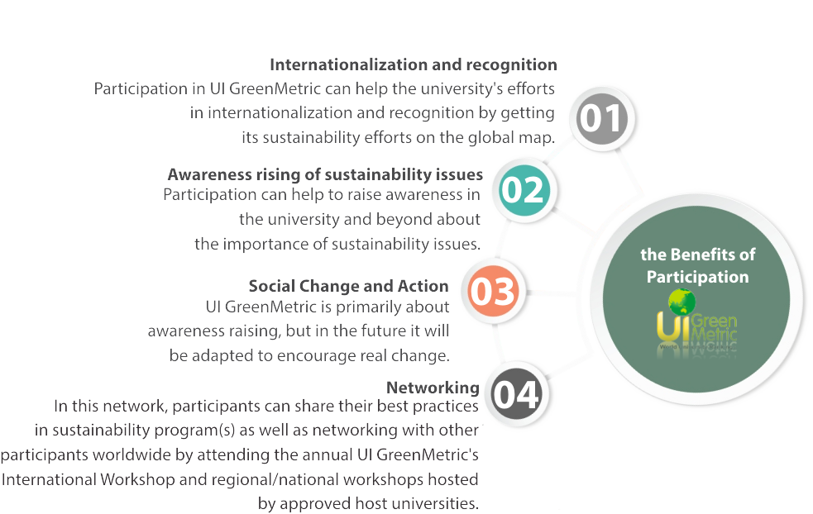
Why joining UI GreenMetric?
UI GreenMetric World University Rankings 2018

Slide 54
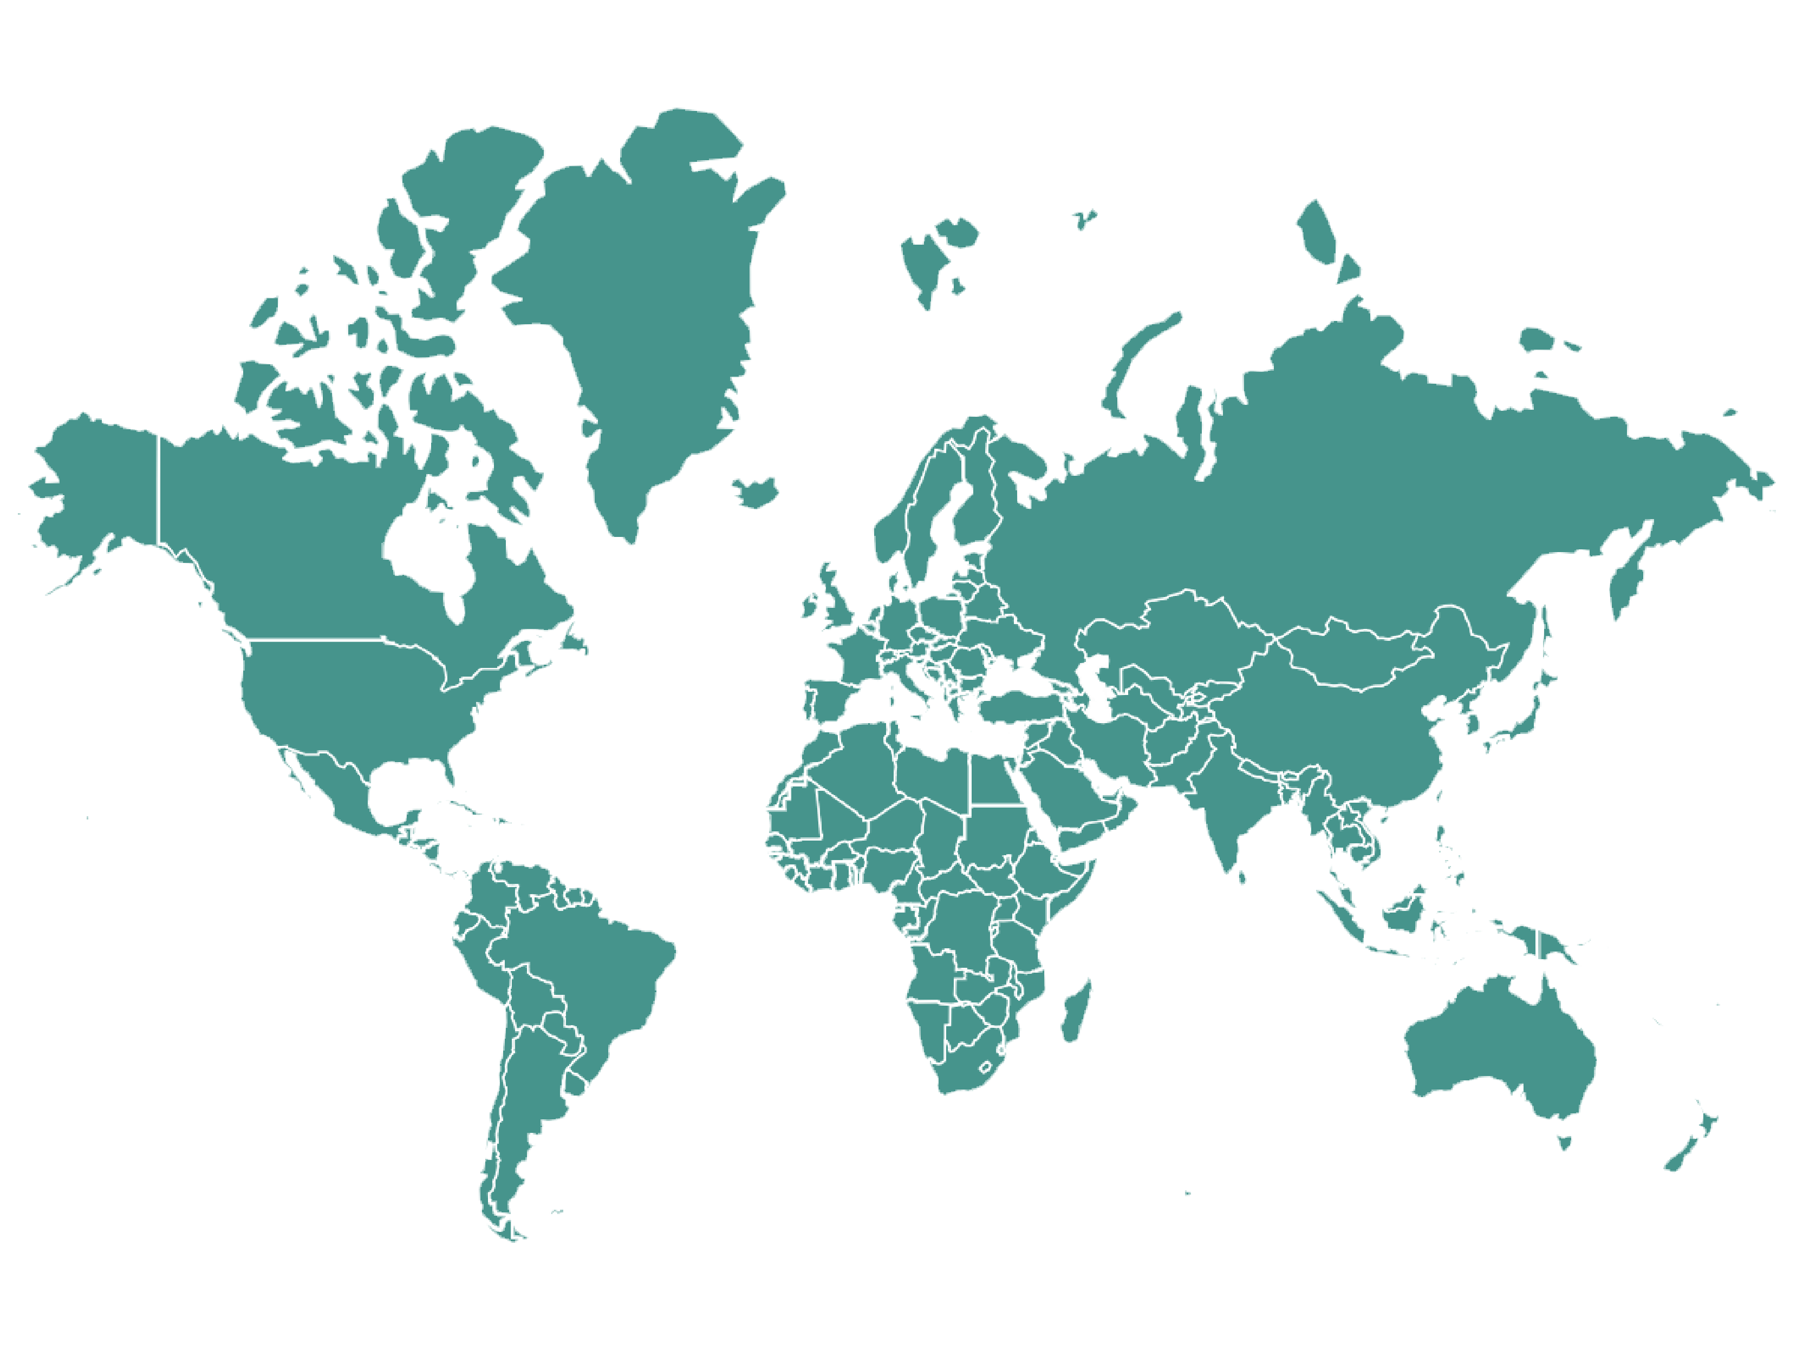


National Coordinator of UI GreenMetric
Jordan: Jordan University of Science and Technology (JUST)
Turkey: Bülent Ecevit University and Istanbul University
Iran: University of Zanjan
Indonesia: Universitas Diponegoro
Thailand: Mahidol University
Colombia: National University of Colombia and El Bosque University
Taiwan: National Pingtung University of Science and Technology (NPUST)
Malaysia: Universiti Utara Malaysia
Saudi Arabia: King Abdul Aziz University
Russia: RUDN University
Kazahkstan: Kazakh National Agrarian University
Brazil: University of Sao Paulo (USP)
Ireland: University College Cork
Italy: University of Bologna
Spain: University of Navarra
Nottingham: University of Nottingham
Denmark: Aalborg University
Austalia: UNSW University
Pakistan: Arid Agriculture University Rawalpindi
China: Shandong Normal University - Lishan College
France: Inseec U.
Japan: Chiba University of Commerce
Portugal: University of Minho
17
10
16
13
21
11
15
14
2
1
3
20
22
19
7
9
4
6
8
5
12
18
UI GreenMetric World University Rankings 2018

Slide 55

























UI GWURN Steering Committee
Universitas Indonesia | Jordan University of Science and Technology | Bülent Ecevit University | University of Zanjan | Universitas Diponegoro | Mahidol University | El Bosque University
National Pingtung University of Science and Technology | Universiti Utara Malaysia | King Abdul Aziz University | People’s Friendship University Russia | Istanbul University | Kazakh National Agrarian University | University of Sao Paulo (USP)
University College Cork | University of Bologna | University of Navarra | University of Nottingham | Aalborg University | University of New South Wales | National University of Colombia
Arid Agriculture University Rawalpindi | Shandong Normal University - Lishan College | Inseec U. | Chiba University of Commerce
UI GreenMetric World University Rankings 2018

Slide 56
Thematic Priority Activities
Partnering on Solutions to Sustainability Challenges
As a global network of universities concerned with sustainability, UI GWURN seeks to advance the efforts of its members and contribute to global society.
Shaping Global Higher Education and Research in Sustainability
Creating Global Sustainability Leaders
UI GreenMetric World University Rankings 2018

Slide 57
UI GreenMetric Agenda in 2018
National Workshop University of Zanjan
and Ferdowsi Univ. of Mashad
6-7 February | Mashad, Iran
4
5
Regional Workshop Atyrau State University
25 April | Atyrau, Kazakhstan
6
National Workshop King Abdulaziz University
April | Jeddah, Saudi Arabia
3
National Workshop Arid Agriculture University
8-9 May | Rawalpindi, Pakistan
8
7
2
5
8
National Workshop Nottingham University
22 May | Nottingham, UK
2
13
1
4
7
National Workshop National University of Colombia
and University del Rosario
5-6 June | Bogota, Colombia
6
7
9
9
11
1
10
National Workshop Univerity of Sao Paulo
8-9 June | Sao Paulo, Brazil
12
10
National Workshop Universiti Utara Malaysia
11 July | Changlun, Malaysia
11
IREG Forum (Hasselt University)
23-25 May | Hasselt, Belgium
12
National Workshop ITS
13 September | Surabaya, Indonesia
2
1
The 4th International Workshop on UI GreenMetric
(IWGM) hosted by Universitas Diponegoro
8-10 April | Semarang, Indonesia
National Workshop Shandong Normal University
Lishan Collage
August | Jinan, China
3
ISCN Conference
(KTH Royal Institute of Technology)
11-13 June | Stockholm, Sweden
13
UI GreenMetric World University Rankings 2018

Slide 58
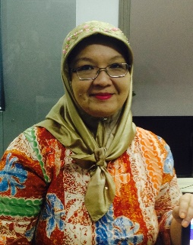
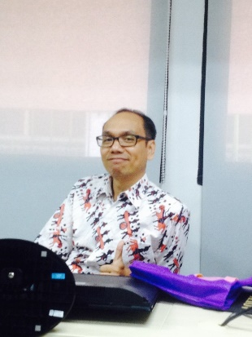
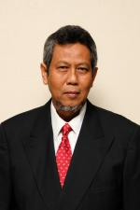


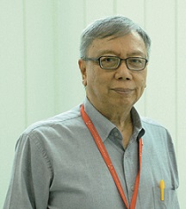
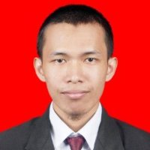
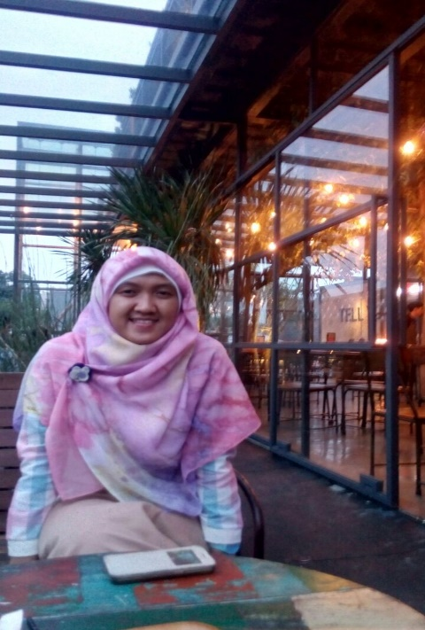



UI GreenMetric Team
Chairperson
Prof. Dr. Riri Fitri Sari, M.Sc., MM
Secretary
Dr. Nyoman Suwartha, S.T., M.T., M.Agr
Expert Member
Prof. Dr. Ir. Tommy Ilyas, M.Eng.
Expert Member
Junaidi, S.S., M.A.
Expert Member
drg. Baiduri Widanarko, MKKK., PhD
Expert Member
Prof. Ir. Gunawan Tjahjono, Ph.D., M.Arch
Programmer
Dr. Ruki Harwahyu, S.T., M.Sc
Analyst and International Communication
Sabrina Hikmah R., S.Si
Communication and Administration
Arsy Imanda N.R., S.Si
Programmer
Rinoto Cahyo, S.Tr
Communication and Administration
Hastin Setiani, S.Si
UI GreenMetric World University Rankings 2018

Slide 59

Ülken rahmet
Үлкен раxмет
UI GreenMetric World University Rankings 2018

